Slide 1
A Computer Architecture Workshop:
Visions for the Future
Celebrating Yale@75
September 19th, 2014
Trevor Mudge
The University of Michigan, Ann Arbor

Slide 2
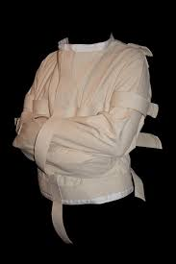
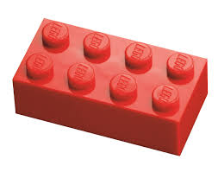
Visions for the Future?
We need to think out-of-the-box
Get back to the basics of computing
Do something radical
Get rid of the von Neumann straight jacket
Our abstractions don’t expose the basic logical fabic
I propose the following: Let’s take a leaf from toys—LEGO
There’s a solution that’s been with us a long time....
It’s a basic building block that digital systems can be constructed from
No –not a NAND gate
It has a higher level of abstraction

Slide 3
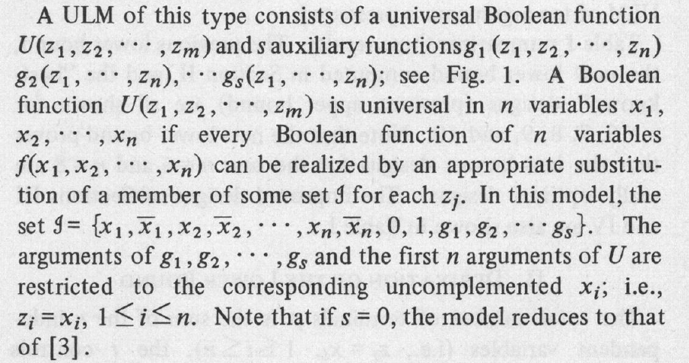
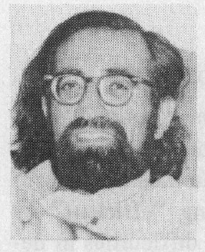
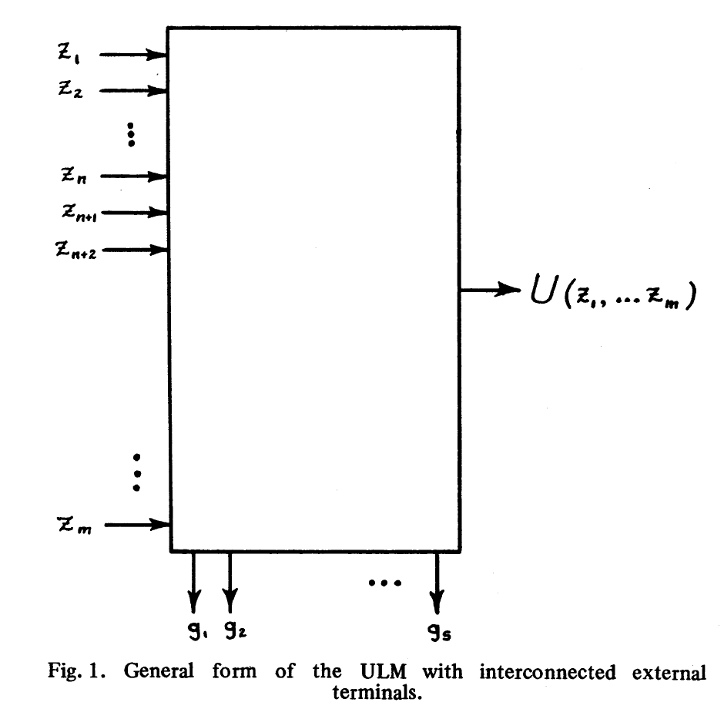
The Universal Logic Module—ULM

Slide 4
Golden Age—Dennard Scaling Worked
About every 2 years we got:
2× area
40% increase in frequency
50% reduction in power
No change in power density
1
Notes:
If s is the linear dimension scaling factor ≈ √2
Device dimension t_{ox}, L, W 1/s
Voltage V 1/s
Current I 1/s
Capacitance εA/t 1/s
Delay VC/I 1/s
Power VI 1/s²
Power density VI/A 1

Slide 5
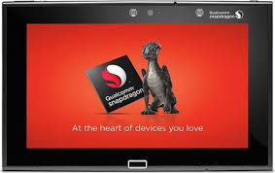
Turn of the Century
Cracks appeared
First crack: frequency scaling became a problem
Vdd got stuck & power density started to creep up
Clock frequency could no longer be a selling point
Core count was the new metric
Later:
Each new tech node no longer showed power and frequency scaling
Node numbers became symbolic names —still followed the 1/√2× sequence
Only area shrank with new nodes
8 64-bit cores

Slide 6
What About Cost?
Two Views
Intel
Everyone else
cost per transistor reached a minimum at 28 nm
Notes:
Qulcomm nvidia imec...

Slide 7
Where Does That Leave Us
No “new” technology that looks promising
Cheap
Reliable
Support density
Can’t see much beyond 7 years
But where’s the capital investment?
From a computer architect’s viewpoint
Fast complex cores have been explored
Multiple cores are being explore
Unlikely to reach large numbers except for data centers / HPC
Application domain specific architectures look promising
Gpu led the way
Only so many applications that warrant specialization

Slide 8
Some Opportunities
Memory—new interesting technologies
3D monolithic FLASH
Various NV-memory technologies
Advanced packaging
3D die stacking
Interposers
Longer time horizon
3D monolithic ICs
—see FLASH
High Bandwidth Memory

Slide 9
FIN

